Slide 1
verbal & Nonverbal communication in group
F
P
T

Slide 2
1.
Two Essential Tools
How many ways you can send a message?

Slide 3
Two Essential Tools
1. Verbal Communication
Focus on How you use words and language
2. Nonverbal Communication
Focus Message components other than words that generate meaning (Eye contacts, body language, gesture…

Slide 4
2.
Language and Meaning
A dog is really “a dog”?

Slide 5
Denotative vs. Connotative
1. Denotative Meaning
The objective, dictionary-based meaning of a word
2. Connotative Meaning
The personal feelings connected to the meaning of a word

Slide 6
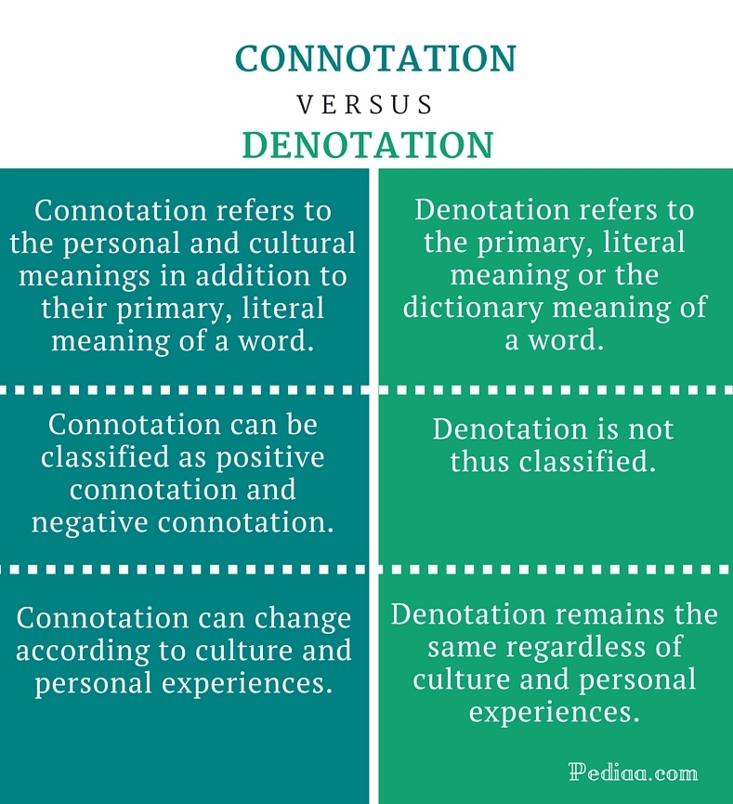
.
Denotation
.
Connotation

Slide 7
3.
Levels of Meaning
Abstract or Concrete???

Slide 8
Levels of Meaning
Abstract Words
Refer to ideas or concepts that cannot be seen or touched such as fairness, freedom, work. Easy to misunderstanding
Ex: organism,animal, pet
Concrete Words
Refer to specific things that can be seen. Concrete words minimize misunderstanding.
Ex: dog, car

Slide 9
4.
Team talk in groups
“Can good language build good group relationships???”

Slide 10
Team Talk in Groups
Functions of Team Talk:
Central to the work of teams. It is the primary medium through which information is exchanged, decisions are made, and plans.
The language group members use as they work together to achieve group goal
Language that reveals where the group is coming from and where it is going
Language that builds group relationships
Anne Donnellon, Team Talk

Slide 11
Match the Team Talk Examples
“Let us develop a reasonable schedule.”
“We’ve done a great job so far,
let’s keep working.”
“Dave, what happened to Jane?”
A. Identification. Plural pronouns.
B. Interdependence. Cooperative, interactive words.
C. Power differential. Equal terms.
B
C
A

Slide 12
Match the Team Talk Examples
D. Social Distance. Casual language, nicknames, slang.
E. Conflict Management. Non-threatening tone, nonjudgmental language.
F. Negotiation Process. “What if” questions; summarize areas of agreement.
F
“What if we delay the meeting?”
“Hey troops, this problem ain’t
a hill to die on.”
“Let’s step back and see if
there’s some area of agreement.”
D
E

Slide 13
List Team Talk Techniques 1
Use the pronouns we, us, and our when referring to the group and its work.
Express shared rather than individual needs. Say” We need to…” rather than “I want.”
If you are in a position of power, refrain from talking and interrupting more than others and asking more questions than others.
Ask group members to address your first name or nickname.

Slide 14
List Team Talk Techniques 2
Speak in a specific and active voice
(“I haven’t finished the report due next week”) rather than
an abstract and passive voice (“The task hasn’t been completed”). Encourage group members to express disagreement
and listen patiently to dissenters.
Ask more “what if” questions and make fewer “we can’t do it” statements.
When in doubt, rephrase or ask questions about what someone else has said to ensure understanding

Slide 15
Use, I, You, and We Language
I: Take responsibility for feelings and actions, but don’t overuse and appear self-centered.
You: Don’t shift responsibility from yourself to others.
We: Use inclusive plural pronouns; share credit for group achievements.

Slide 16
5.
Language Difficulties
“How misunderstanding in group discussion could be avoided?”

Slide 17
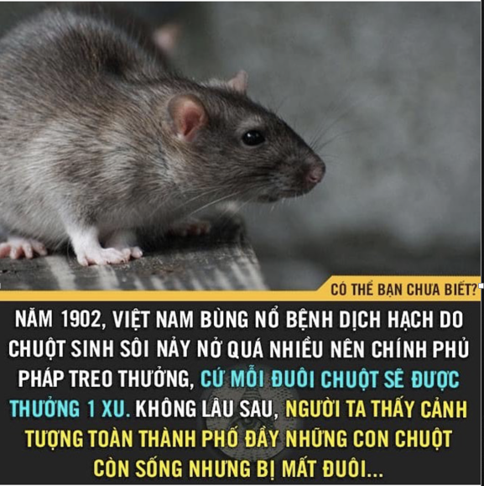
Bypassing
A form of miscommunication that occurs when people “miss each other with their meanings.”
French colony government announced
“A penny reward for ONE mouse’tail”
Our brilliant Vietnamese ancestors thought
“Golden chance to earn money!”
WINNER OF SHARK TANK 1902
THEY BUILT MICE FARM TO GET TAILS

Slide 18
Offensive Labels
I’m relaxed; you’re untidy; she’s a slob.
I’m energetic; you’re excitable; he’s out of control.
I’m full-figured; she’s overweight; Karen is so fat
Our group works hard; Lucinda’s group members are workaholics; Greg’s group members are sloths
Terminology that demeans, inappropriately excludes, or stereotypes people (discrimination)
A black doctor,
A dumb blonde, a deaf cousin
or a rich uncle

Slide 19
Jargons
My own story with my first meeting @ TVG
“We need to carry out shortly our plan to improve load factor of all ANA flights between SGN – NRT up to 80% because JAL already got 75% last season. Our new appointed CMO, Mr Hee, will join the the team to help speed up our FTP and launch it in January or sooner.”
The specialized or
technical language
of a profession.
Am I invisible???

Slide 20
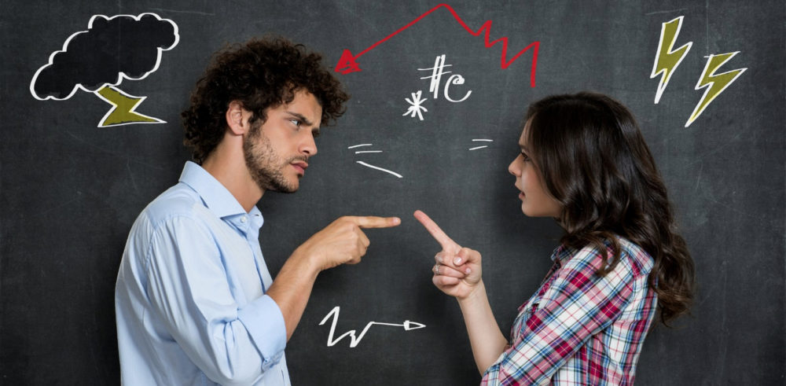
Sticks and Stones May Break Your Bones, but Words Can Hurt Forever - Arthur bell, You Can’t Talk to Me That Way! - - .

Slide 21
Verbal Abuse
Forms of Verbal Abuse
Tone of Voice
Content
Language choice
Nonverbal Cues
Speaking Volume
Examples
Harsh, sarcastic, angry
Sexual references, racial slurs, cruel comments about someone’s appearance
Foul or obscene words
Insulting facial expressions, gross gestures, threatening movements
Loud, screaming voice or hissed messages2

Slide 22
How to Curb Verbal Abuse
Express your objections: Don’t ignore and keep silent
Ask for repetition: “Please repeat that.”
Physically step back from the person: 4 or 5 steps OR walk away
Quote the law or Group Norms: By law, it is illegal!
Take a time-out: Say “Time out” “Let’s take a minute to calm down before we continue.”
Practice what you preach: Avoid all forms of verbal abuse: • Do not raise your voice. • Do not swear. • Do not call members insulting names. • Do not use sarcasm to wound others.
Listen: Listen more than you speak when you’re upset. Calm down!

Slide 23
6.
Adapting to Language differences
“Don’t let differences create misunderstanding!”

Slide 24
Language & cultures: Codeswitching
The ability to change from the dialect of your own culture and adopt the language of the majority in a particular situation
People may learn codeswitching to avoid negative stereotypes about them based on their dialect.

Slide 25
Quiz
Research on dialects, reveals that . . .
People judge others by their dialect.
People seeking career success often change their dialect to Standard American Speech.
Standard American Speech is most accepted by the majority of the American culture.
We should be aware of dialect prejudices and look beyond the surface when judging others.
All of the above.

Slide 26
7.
Nonverbal communication
“Speech is Silver, Silence is Golden”

Slide 27
Nonverbal Communication
The behavioral elements of messages other than the actual words spoken
60-70%
of all meaning is communicated nonverbally.
!

Slide 28
Types of Nonverbal Communication
Personal Appearance
Facial Expression and Eye Contact
Vocal Expression
Pitch, rate, volume, vocal variety, word stress
Physical Expression
Movement, posture, touch 💑
Environment
Arrangement of space, use of personal space

Slide 29
Facial Expression
We can produce more than 1,000 different facial expressions.
Facial expressions allow non-speakers to contribute to ongoing group discussions.
The Significance of Eye Contact:
Lack of eye contact may be perceived as rudeness, indifference, nervousness, or dishonesty.
Eye contact norms are culturally determined.
Eye contact influences interaction in small groups.

Slide 30
Physical Expression
Kinesics - The study of body movement and physical expression
Touch can express encouragement, support, or happiness.
BUT IT TOTALLY DEPENDS ON WHERE YOU TOUCH!
Interaction between touch approachers and touch avoiders can create misunderstandings.

Slide 31
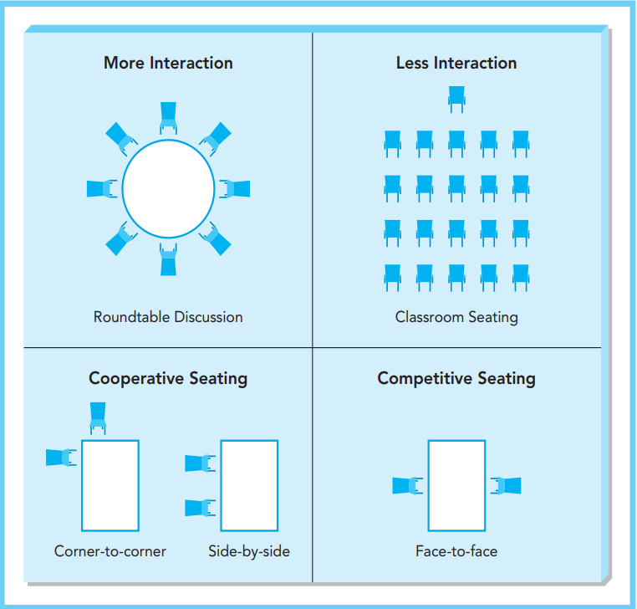
Seating Arrangements

Slide 32
Seating Positions
Choice of seating position in groups
For cooperative activities: Sit corner-to-corner or side-by-side
For competitive activities: Sit across from one another
Task leaders sit at the head of a table
Social leaders sit in the middle of a side

Slide 33
Territoriality
The sense of personal ownership that is attached to a particular space
Examples:
Your usual seat in a classroom or meeting room
Marking your territory with objects (purse, book, coat, food)
Members who fail to respect the territory of others violate an important group norm.

Slide 34
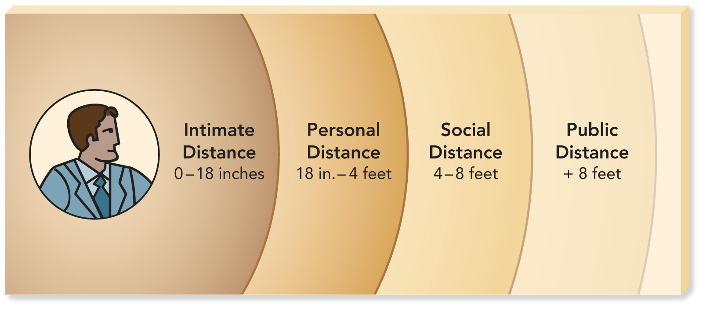
Zones of Personal Space in North America

Slide 35
Quiz
At what distance do members of most well-established groups interact?
Intimate distance
Personal distance
Social distance
Business distance
Public distance

Slide 36
Create a Supportive Communication Climate
A group’s climate is the degree to which members feel comfortable interacting.
Jack Gibb describes six dialectic behaviors that influence whether a group’s climate is supportive or defensive.

Slide 37
Group Climate Dialectics
Supportive Climate
Description
Problem Orientation
Spontaneity
Empathy
Equality
Provisionalism
Defensive Climate
Evaluation
Control
Strategy
Neutrality
Superiority
Certainty

Slide 38
Quiz
What type of supportive or defensive response is illustrated in the statement: “That’s a stupid way to approach the problem”?
Descriptive
Evaluative
Problem-oriented
Strategic
Empathic

Slide 39
Nonverbal Immediacy
Leaning forward
Physical closeness to others
Eye contact
Openness of arms and body
Touching
Direct body orientation
Relaxed posture
Positive facial and vocal expressions
Laughing and smiling

